Slide 1
Logistic Regression Model
Source of Material:
Data Science and Big Data Analytics, EMC Education Services, John Wiley & Sons, 2015

Slide 2
Outline
Typology of regression models (recap)
Logical regression: When and Why
The logistic regression model
Model evaluation and interpretation of the results

Slide 3
Typology of Regression Models
In linear regression modeling, the outcome variable is continuous – e.g., income ~ age and education
In logistic regression, the outcome variable is categorical, such as two-valued outcomes like true/false, pass/fail, or yes/no
Type of outcome variable
Continuous
Linear
Non-
linear
Discrete/
Categorical
Binary
Multi-nomial
Multiple Regression
Logistic Regression

Slide 4
Logistic Regression: When and Why
To predict an outcome variable that is categorical based on one or more categorical and/or continuous predictor variables
Used because having a categorical outcome variable violates the assumption of linearity in linear regression
Logistic regression does not assume a linear relationship between outcome variable and predictor variables

Slide 5
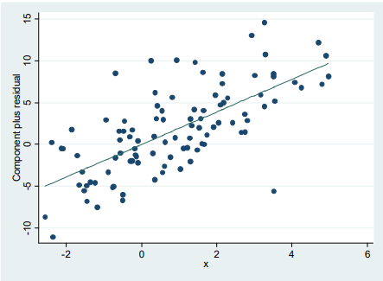
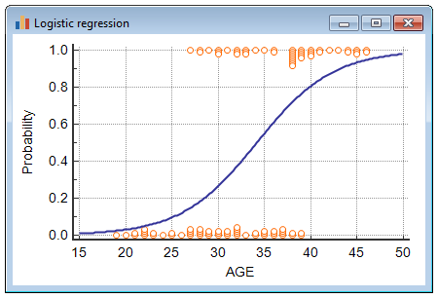
Logistic Regression: When and Why
Linear Regression Logistic Regression

Slide 6
Logistic Regression: When and Why
No assumptions about the distribution of predictor variables
Predictors do not have to be normally distributed.
Logistic regression does not make any assumptions of normality, linearity and homogeneity of variance for the predictor variables

Slide 7
Logistic Regression Use Cases
>
Medical
Probability of a patient’s successful response to a specific medical treatment – input could include age, weight, etc.
Finance
Probability an applicant defaults on a loan
Marketing
Probability a wireless customer switches carriers (churns)
Engineering
Probability a mechanical part malfunctions or fails

Slide 8

Logistic Regression Model
The goal of logistic regression is to find the best fitting model to describe the relationship between the dichotomous characteristic of interest (dependent variable = response or outcome variable) and a set of independent (predictor or explanatory) variables.
Logistic regression generates the coefficients (and its standard errors and significance levels) of a formula to predict a logit transformation of the probability of presence of the characteristic of interest:
where p is the probability of presence of the characteristic of interest.

Slide 9
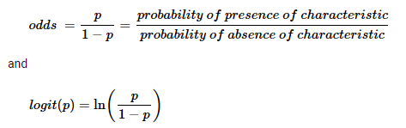
Logistic Regression Model
The logit transformation is defined as the odds that of the characteristic of interest is present:
Rather than choosing parameters that minimize the sum of squared errors (like in ordinary regression), estimation in logistic regression chooses parameters that maximize the likelihood of observing the sample values.

Slide 10



Logistic Regression Model
>
With the range of f(y) as (0,1), the logistic function models the probability of an outcome occurring
In contrast to linear regression, the values of y are not directly observed; only the values of p(y) in terms of success or failure are observed.
Typical model estimated in logistic regression. Maximum Likelihood Estimation (MLE) is used to estimate model parameters.

Slide 11


Logistic Regression Model: Odds
Odds(Y=1) = P/(1-P)
Given that P = Odds/(1+Odds) and that:
It follows that :
Odd(Y=1) =
Converting to natural logarimth form, we get:

Slide 12
Evaluation of the Logistic Regression Model
Overall model fit
Deviance statistic: defined as the lack of fit between model and data.
In general, the larger the deviance, the poorer the fit to the data
The deviance in usually not interpreted directly, but rather compared to deviance(s) from other models fitted to the same data.
We compute the difference between Null deviance (i.e., deviance for model with no predictors) and Residual deviance (i.e., model with predictors included)

Slide 13
Evaluation of the Logistic Regression Model
Overall Model Fit
The computed difference in deviance can be tested using a chi-square distribution with degrees of freedom equal to the difference in the number of parameters estimated (i.e., null deviance df – residual deviance df).
Large values of the chi-square statistic are taken as evidence that the null hypothesis is implausible.

Slide 14
Evaluation of the Logistic Regression Model
Individual Coefficients
Use z-values and p-values
Estimated coefficients with large z-values and p-values less than 0.05 are statistically significant.
Interpreting results in terms of odds
The odds of the outcome variable associated with each estimated coefficient = exp(coefficient)
For example, if the estimated coefficient is β1, then the odds of the outcome variable being observed with respect to that predictor = exp(β1)

